Slide 1
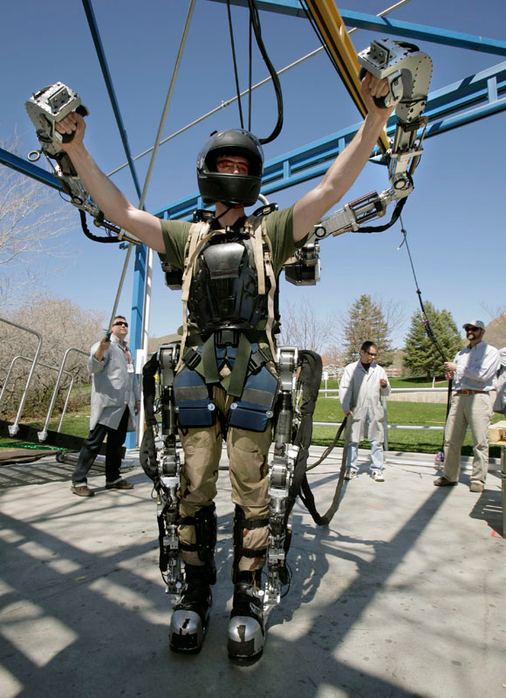
XOS 2 Exoskeleton Suit
Mr. Palmucci

Slide 2
History
Developed by a military defense contractor.
Design began in 2000.
Designer wanted to create a real life ironman suit.

Slide 3
Tasks
Allow soldiers the ability to:
  lift heavy objects
  hike for long periods of time
  handle heavy weapons with little or no fatigue.

Slide 4
Where is the Robot Used?
Still in Developmental Phases
Can only go as far as it’s power cord allows, since there are no batteries that can last long enough to power it for more than a few minutes at a time.
About five years away from being realistically used by the military.

Slide 5
Multi-funcitonal?
No, the XOS2 is not multi-functional.
Can only perform whatever task the operator is trying to perform

Slide 6
How is the Robot Programmed?
The robot is controlled by the operator wearing the exoskeleton suit.
It cannot be controlled by a computer.

Slide 7
Sensors
The X0S 2 is loaded with sensors.
The suit has 6 pressure sensors that react to the operators movement the instant they move.
The sensors allow the advanced hydraulic system to flow through the suit to eliminate any stress to the user.

Slide 8
Advantages/Disadvantages
Advantages | Disadvantages
Allow operator to perform tasks without fatigue | Needs to be plugged in for power supply
Can make 200 pounds feel like only 2. | If suit explodes, potentially deadly.
Help soldiers perform dangerous task more safe. | Price

Slide 9
Impact
The XOS 2 can allow soldiers to function at a high level for a much longer period of time.

Slide 10
Jobs/Careers
The jobs this can provide are manufacturing the suits for the military.
They have already created jobs by needing to be developed and then tested.

Slide 11
The Future
While still in development stages, the XOS 2 will be mobile in the future.
It will be able to operate on a battery or some type of alternative energy source.
It will also become a full suit of armor rather than an exoskeleton and be bullet proof.

Slide 12
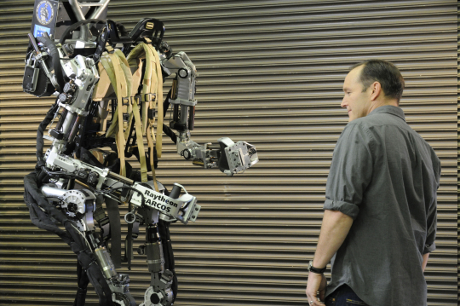
Pictures
http://news.cnet.com/2300-11386_3-10004983-4.html?tag=mncol

Slide 13
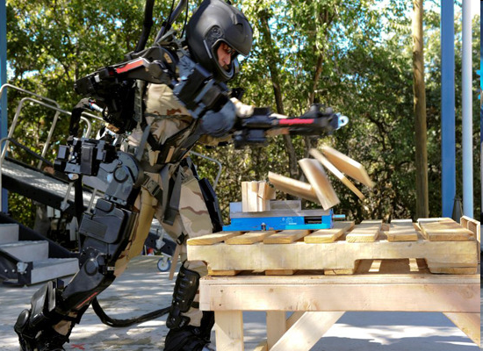
Pictures
http://news.cnet.com/8301-13772_3-20017778-52.html

Slide 14
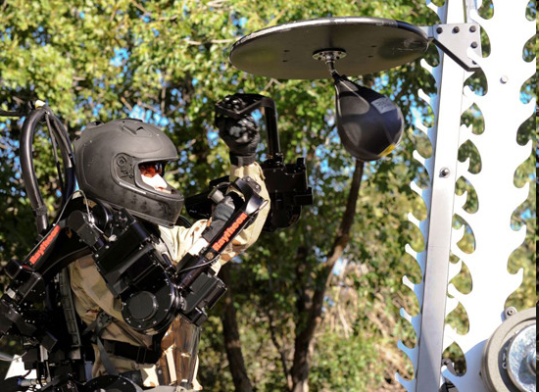
Pictures
http://news.cnet.com/2300-11386_3-10004983-7.html?tag=mncol

Slide 15

Video
Discovery Channel Link

Slide 16
Sources
http://www.popsci.com/scitech/article/2008-04/building-real-iron-man?page=1
http://news.cnet.com/8301-13772_3-20017778-52.html
http://www.armytimes.com/news/2008/05/ap_roboticsuit_051508/
http://articles.cnn.com/2010-11-11/tech/iron.man.suit_1_suit-moves-metal-suit-iron-man?_s=PM:TECH

